Slide 1
NetSim
TM
Internet Of Things (IOT)
Model - Predict - Validate
LTE - Code Walkthrough
Twitter.com/tetcos
linkedin.com/tetcos
youtube.com/tetcos

Slide 2
LTE 3GPP Standard
LTE (Long-Term Evolution, commonly marketed as 4G LTE) is a standard for wireless communication of high-speed data for mobile phones and data terminals.
The standard is developed by the 3GPP (3rd Generation Partnership Project) and NetSim implementation is as per Release 10.
The reader is expected to have completed / know
LTE experiment (present in experiment manual)
“Hello World” program (present in user manual) in NetSim
Debugging of code via GUI in NetSim (present in the user manual)

Slide 3
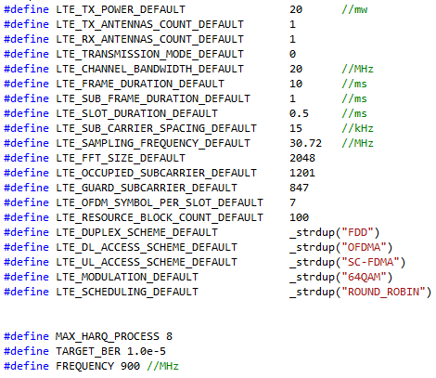
LTE Default config parameters

Slide 4
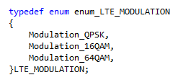
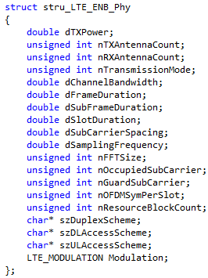
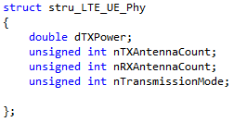
Important Data Structures
Supported Modulation Types: ENB PHY Varaiables
UE PHY Variables:
ENB PHY Variables:

Slide 5
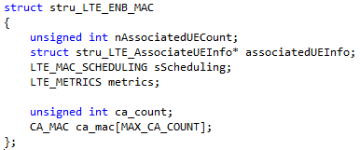
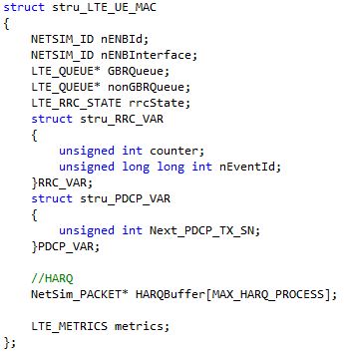
Important Data Structures
ENB MAC Variables
UE MAC Variables

Slide 6
Events Handled by LTE
MAC_OUT_EVENT
MAC_IN_EVENT
PHYSICAL_OUT_EVENT
PHYSICAL_IN_EVENT
NETWORK_OUT_EVENT
NETWORK_IN_EVENT
TIMER_EVENT
LTE_TXNEXTFRAME
LTE_T300_Expire
Check the architecture under Section 6.6 , in the User Manual for better understanding.

Slide 7
MAC_OUT_EVENT
This would be the first LTE Event called when a packet in the Source node reaches the MAC layer.
This event examines whether the device involved is a UE or a ENB.
If the device is a UE then the function fn_NetSim_LTE_AddInQueue() is called.
fn_NetSim_LTE_AddInQueue()
RRC Initialization is done (only for the first packet)
PDCP Initialization is done (for all the packets)
Based on Packet QOS
If UGS, packet Is added to GBR Queue
If non – UGS, packet is added to non – GBR Queue.

Slide 8
MAC_OUT_EVENT
If the device is a ENB then the control data type is verified, and respective functions are called in each case,
LTEPacket_HandoverRequest
fn_NetSim_LTE_ProcessHORequest() is called if handover request packet is received
LTEPacket_HandoverRequestAck
fn_NetSim_LTE_ProcessHORequestAck() is called to send ack for handover request.
Other control data types
fn_NetSim_LTE_eNB_AddInQueue()
Initialises paging request
Initialises PDCP
Based on packet QOS
If UGS, packet is added to GBR Queue
If non – UGS, packet is added to non – GBR Queue.

Slide 9
MAC_IN_EVENT
This event is called at an intermediate device or receiver on receipt of a packet.
This event examines whether the device involved is a ENB or a UE.
If the device is a ENB then the control data type is verified, and respective functions are called in each case,
LTEPacket_RRC_CONNECTION_REQUEST
fn_NetSim_LTE_RRC_ProcessRequest() function is a part of the RRC Connection setup.
LTEPacket_RRC_CONNECTION_SETUP_COMPLETE
fn_NetSim_LTE_RRC_SetupComplete() function is a part of the RRC Connection setup.
LTEPacket_RLC_SDU
fn_NetSim_LTE_RLC_eNB_In() function is called for all the packets.
LTEPacket_MeasurementReport
fn_NetSim_LTE_DecideHandover() function decides handover based on received power.
LTEPacket_ACK
fn_NetSim_LTE_ENB_ProcessAck() function is called for layer 2 acks.

Slide 10
MAC_IN_EVENT
If the device is a UE then the control data type is verified, and respective functions are called in each case,
LTEPacket_RRC_CONNECTION_SETUP
fn_NetSim_LTE_RRC_ProcessSetup() function is a part of the RRC Connection setup LTEPacket_Paging
fn_NetSim_LTE_ProcessPage() function is a part of the RRC Connection setup.
LTEPacket_RLC_SDU
fn_NetSim_LTE_RLC_UE_In() function is called for each packet.
LTEPacket_ACK
fn_NetSim_LTE_UE_ProcessAck() function is called for layer 2 acks.

Slide 11
PHYSICAL_OUT_EVENT
Update PHY layer parameters.
Has no major functions.
Only adds PHY_IN for next device.

Slide 12
PHYSICAL_IN_EVENT
This event examines whether the device involved is a enb
If it is a enb handover is in progress, packet status is set to dropped and packet trace and metrics are updated with this change.
In all other cases the packet status is updated using fn_NetSim_LTE_DecideError()
fn_NetSim_LTE_DecideError() function decides error based on received power and MCS Index.
If the packet status is error , then packet trace and metrics are updated .
Else MAC_IN event is added to the stack.

Slide 13
NETWORK_OUT_EVENT
MME is the only layer 3 device in LTE
This event examines whether the device involved is an MME
If it is an MME then fn_NetSim_LTE_MME_RoutePacket() function is called.
fn_NetSim_LTE_MME_RoutePacket()
Routes packets based on HLR
MAC_OUT event is added.

Slide 14
NETWORK_IN_EVENT
This event examines whether the device involved is an MME
If the device is an MME then the control data type of the packet is examined,
If control data type is LTEPacket_HandoverRequest or LTEPacket_HandoverRequestAck then fn_NetSim_LTE_MME_RouteHOPacket() is called and the packet’s transmitter id is updated with the current device id and stored in the buffer of the current device.
Else the packet is not processed and is passed to the IP layer.
Else the packet is not processed and is passed to the IP layer.

Slide 15
TIMER_EVENT
LTE_T300_Expire
This is the RRC Connection establishment timer.
The function fn_NetSim_LTE_T300_Expire() is called and PHYSICAL_OUT_EVENT is added after creating a LTEPacket_RRC_CONNECTION_REQUEST type control packet.
If RRC is not connected then the request is sent again.
LTE_TXNEXTFRAME
This forms the complete uplink and downlink frames.
fn_NetSim_LTE_FormNextFrame()
If LTE ack is not received, retransmit packet in buffer.
Schedule all the packets in buffer based on the scheduling technique and available bandwidth (bits in Transport block size)
Form RLCSDU

Slide 16
MAC Scheduling
Key functions:
fn_NetSim_LTE_InitQueue()
fn_NetSim_LTE_AddInQueue ()
fn_NetSim_LTE_eNB_AddInQueue ()
fn_NetSim_LTE_FormNextFrame ()
fn_NetSim_LTE_FormUPlinkFrame ()
CompareGBR ()
CompareNonGBR ()
fn_NetSim_LTE_FormDownlinkFrame_RoundRobin ()
fn_NetSim_LTE_FormDownlinkFrame_MaxCQI ()
fn_NetSim_LTE_FormDownlinkFrame_ProportionalFairScheduling ()
fn_NetSim_LTE_FormDownlinkFrame ()

Slide 17
Thank You !
Tetcos
Support
Website
#214 7th Main, 39th A Cross,
Jayanagar 5th Blk,
Bangalore.
India
Pin – 560041
Tele-fax : + 91 80 2663 0624
support@tetcos.com
www.tetcos.com
Youtube
Twitter
youtube.com/tetcos
@Tetcos

